Slide 1
Encapsulation & Abstraction

Slide 2
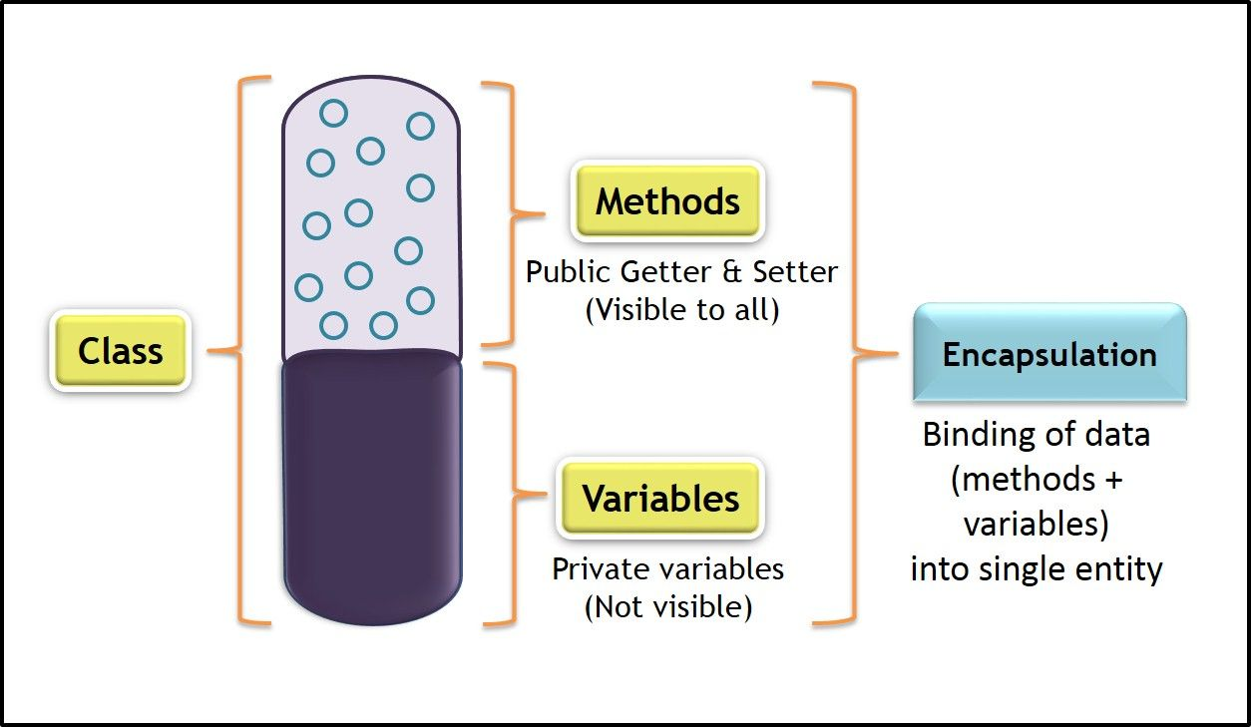
Encapsulation

Slide 3
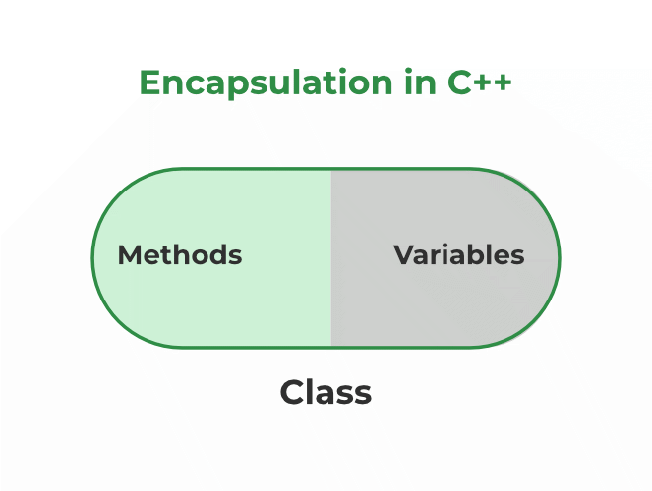
Encapsulation
Encapsulation in C++ is defined as the wrapping up of data and information in a single unit. In Object Oriented Programming, Encapsulation is defined as binding together the data and the functions that manipulate them.

Slide 4
Encapsulation
Consider a real-life example of encapsulation, in a company, there are different sections like the accounts section, finance section, sales section, etc. Now,
The finance section handles all the financial transactions and keeps records of all the data related to finance.
Similarly, the sales section handles all the sales-related activities and keeps records of all the sales.
Now there may arise a situation when for some reason an official from the finance section needs all the data about sales in a particular month.
In this case, he is not allowed to directly access the data of the sales section. He will first have to contact some other officer in the sales section and then request him to give the particular data.
This is what Encapsulation is. Here the data of the sales section and the employees that can manipulate them are wrapped under a single name “sales section”.

Slide 5
Encapsulation
Two Important property of Encapsulation
Data Protection: Encapsulation protects the internal state of an object by keeping its data members private. Access to and modification of these data members is restricted to the class’s public methods, ensuring controlled and secure data manipulation.
Data Hiding: Encapsulation hides the internal implementation details of a class from external code. Only the public interface of the class is accessible, providing abstraction and simplifying the usage of the class while allowing the internal implementation to be modified without impacting external code.

Slide 6
Encapsulation
Features of Encapsulation
We can not access any function from the class directly. We need an object to access that function that is using the member variables of that class.
The function which we are making inside the class must use only member variables, only then it is called encapsulation.
If we don’t make a function inside the class which is using the member variable of the class then we don’t call it encapsulation.
Increase in the security of data
It helps to control the modification of our data members.
Data hiding:
Data hiding is an important aspect of encapsulation that enables the data members of a class to be hidden from the clients of the class. By making the data members private and enabling accessor and mutator functions to access and modify the data members, data hiding can be accomplished.

Slide 7
Example 1 Code:
#include <iostream>
using namespace std;
class Encapsulation {
private:
// Data hidden from outside world
int x;
public:
// Function to set value of
// variable x
void set(int a) { x = a; }
// Function to return value of
// variable x
int get() { return x; }
};
Explanation: In the above program, the variable x is made private. This variable can be accessed and manipulated only using the functions get() and set() which are present inside the class. Thus we can say that here, the variable x and the functions get() and set() are bound together which is encapsulation.
int main()
{
Encapsulation obj;
obj.set(5);
cout << obj.get();
return 0;
}
Output 5

Slide 8
Example 2 Code:
#include <iostream>
using namespace std;
class Rectangle {
private:
// Variables required for area calculation
int length;
int breadth;
public:
// Setter function for length
void setLength(int len) {
length = len;
}
// Setter function for breadth
void setBreadth(int brth) {
breadth = brth;
}
int main() {
// Create object of Rectangle class
Rectangle rectangle1;
// Initialize length using Setter function
rectangle1.setLength(8);
// Initialize breadth using Setter function
rectangle1.setBreadth(6);
// Access length using Getter function
cout << "Length = " << rectangle1.getLength() << endl;
// Access breadth using Getter function
cout << "Breadth = " << rectangle1.getBreadth() << endl;
// Call getArea() function
cout << "Area = " << rectangle1.getArea();
return 0;
}
// Getter function for length
int getLength() {
return length;
}
// Getter function for breadth
int getBreadth() {
return breadth;
}
// Function to calculate area
int getArea() {
return length * breadth;
}
};

Slide 9
Explanation of Example 2
Here, we have made the length and breadth variables private.
This means that these variables cannot be directly accessed outside of the Rectangle class.
To access these private variables, we have used public functions setLength(), getLength(), setBreadth(), and getBreadth(). These are called getter and setter functions.
Making the variables private allowed us to restrict unauthorized access from outside the class. This is data hiding with Encapsulation.
If we try to directly access the variables from the main() class, we will get an error.

Slide 10
Role of Access Specifiers in Encapsulation
Access specifiers facilitate Data Hiding in C++ programs by restricting access to the class member functions and data members. There are three types of access specifiers in C++:
Private
Protected
Public
Access specifiers play an important role in implementing encapsulation in C++. The process of implementing encapsulation can be sub-divided into two steps:
Creating a class to encapsulate all the data and methods into a single unit.
Hiding relevant data using access specifiers.

Slide 11
Benefits of Encapsulation
Encapsulation provides several benefits, including:
Improved code maintainability: Encapsulation helps in improving the code maintainability by providing a clear separation between the implementation details of a class and its clients.
Data hiding: Encapsulation enables data hiding, which protects the data members of a class from being accessed and modified by the clients of the class.
Code reuse: Encapsulation helps in code reuse by providing a modular design that can be easily extended and modified.
Security: Encapsulation provides security by preventing unauthorized access to the data members of a class.

Slide 12
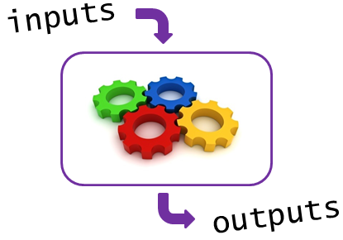
Abstraction

Slide 13
Abstraction
Data abstraction refers to providing only essential information to the outside world and hiding their background details, i.e., to represent the needed information in program without presenting the details.
Data abstraction is a programming (and design) technique that relies on the separation of interface and implementation.
With data abstraction we think about what operations can be performed on a particular type of data and not how it does it

Slide 14

Abstraction
Consider a real-life example of a man driving a car. The man only knows that pressing the accelerator will increase the speed of the car or applying brakes will stop the car but he does not know how on pressing the accelerator the speed is actually increasing, he does not know about the inner mechanism of the car or the implementation of the accelerator, brakes, etc in the car. This is what abstraction is.

Slide 15
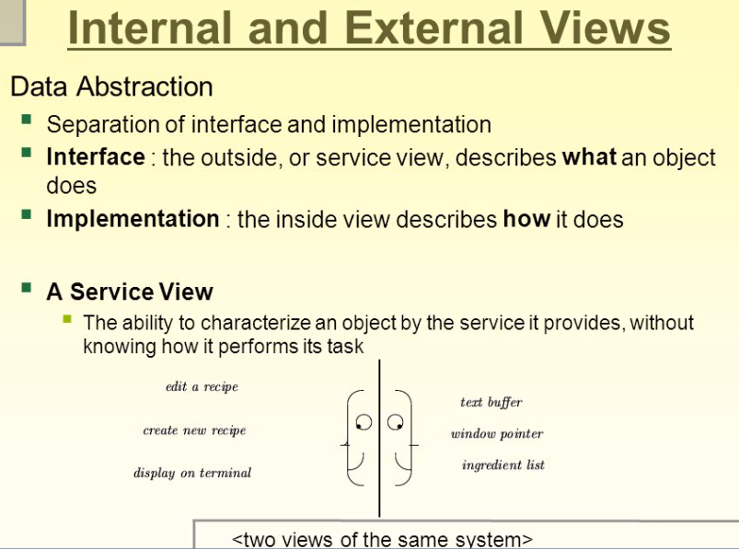
Abstraction

Slide 16
Data Abstraction
Data Abstraction is one of the most powerful programming paradigms
It allows us to create our own user defined data types (using the class construct) and
then define variables (i.e., objects) of those new data types.
With data abstraction we think about what operations can be performed on a particular type of data and not how it does it
Data abstraction is used as a tool to increase the modularity of a program
It is used to build walls between a program and its data structures
what is a data structure?
talk about some examples of data structures
We use it to build new abstract data types
16

Slide 17
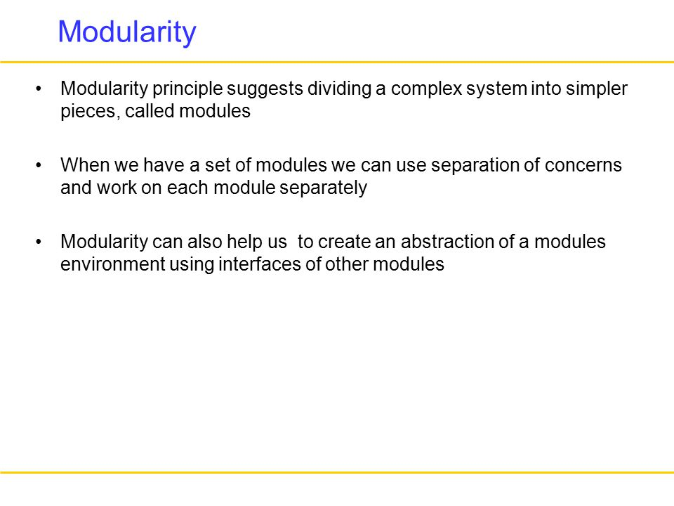


Slide 18
Data Abstraction
An abstract data type (ADT) is a data type that we create
consists of data and operations that can be performed on that data
An abstract data type is any type you want to add to the language over and above the fundamental types
For example, you might want to add a new type called: list
which maintains a list of data
the data structure might be an array of structures
operations might be to add to, remove, display all, display some items in the list
CS202 Topic #2
18

Slide 19
Data Abstraction
Once defined, we can create lists without worrying about how the data is stored
We “hide” the data structure used for the data within the data type -- so it is transparent to the program using the data type
We call the program using this new data type: the client program (or client)
CS202 Topic #2
19

Slide 20
Data Abstraction
Once we have defined what data and operations make sense for a new data type, we can define them using the class construct in C++
Once you have defined a class, you can create as many instances of that class as you want
Each “instance” of the class is considered to be an “object” (variable)
Think of a class as similar to a data type
and an object as a variable
And, just as we can have zero or more variables of any data type...
we can have zero or more objects of a class!
Then, we can perform operations on an object
CS202 Topic #2
20

Slide 21
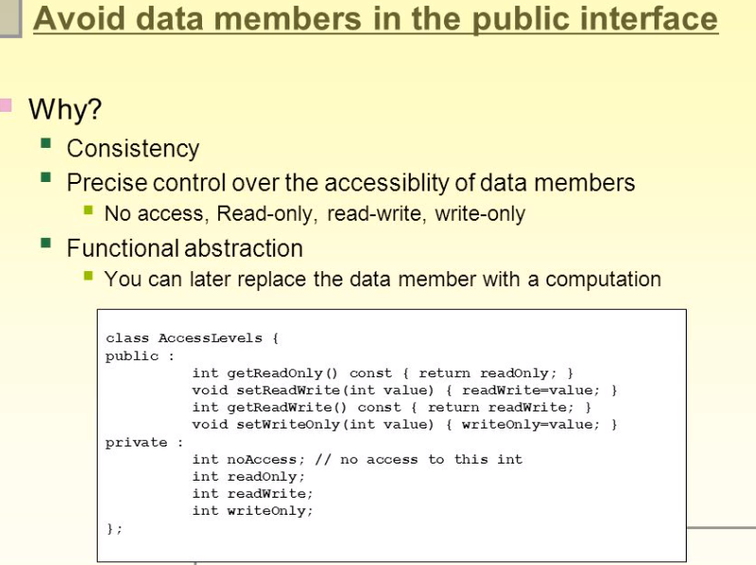
Abstraction

Slide 22
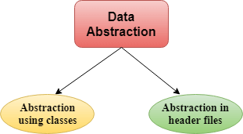
Abstraction
Abstraction using classes: An abstraction can be achieved using classes. A class is used to group all the data members and member functions into a single unit by using the access specifiers. A class has the responsibility to determine which data member is to be visible outside and which is not.
Abstraction in header files: An another type of abstraction is header file. For example, pow() function available is used to calculate the power of a number without actually knowing which algorithm function uses to calculate the power. Thus, we can say that header files hides all the implementation details from the user.

Slide 23
Abstraction using header file example
In the example, pow() function is used to calculate 4 raised to the power 3. The pow() function is present in the math.h header file in which all the implementation details of the pow() function is hidden.
#include <iostream>
#include<math.h>
using namespace std;
int main()
{
int n = 4;
int power = 3;
int result = pow(n,power); // pow(n,power) is the power function
std::cout << "Cube of n is : " <<result<< std::endl;
return 0;
}

Slide 24
Abstraction using Class example
#include <iostream>
using namespace std;
class Sum
{
private: int x, y, z; // private variables
public:
void add()
{
cout<<"Enter two numbers: ";
cin>>x>>y;
z= x+y;
cout<<"Sum of two number is: "<<z<<endl;
}
};
int main()
{
Sum sm;
sm.add();
return 0;
}
In the example, abstraction is achieved using classes. A class 'Sum' contains the private members x, y and z are only accessible by the member functions of the class.

Slide 25
Difference between abstraction and encapsulation
S.NO | Abstraction | Encapsulation
1. | Abstraction is the process or method of gaining the information. | While encapsulation is the process or method to contain the information.
2. | In abstraction, problems are solved at the design or interface level. | While in encapsulation, problems are solved at the implementation level.
3. | Abstraction is the method of hiding the unwanted information. | Whereas encapsulation is a method to hide the data in a single entity or unit along with a method to protect information from outside.
4. | We can implement abstraction using class and abstract interfaces. | Whereas encapsulation can be implemented using by access modifier i.e. private, protected and public.
5. | In abstraction, implementation complexities are hidden using classes and interfaces. | While in encapsulation, the data is hidden using methods of getters and setters.
6. | The objects that help to perform abstraction are encapsulated. | Whereas the objects that result in encapsulation need not be abstracted.

Slide 26
Thank you!!!

